Slide 1
Employee Record System Using C Language

Slide 2
Submitted By :--
Avijit kumar halkiya
Siddharth Sharma
Satyam Tomaar
Syed Ruhaan Qadri
Divya Gambhir

Slide 3

Employee Record System:-
It is a software built to handle the primary housekeeping functions of a company.
Objective:
This project is build to handle records of employees of a company. It helps to keep a track of all the employee’s records in a file.

Slide 4


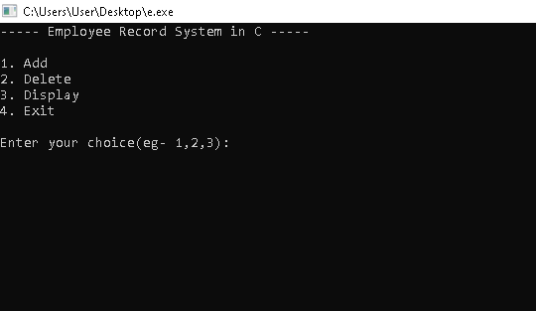
System Environment:
IDE: - Dev C++
Language: - C Language
It has 3 functions:
Add A New Record
Display all Records and.
Delete A Record.

Slide 5
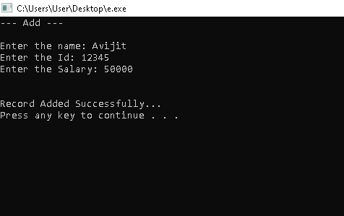

Add A New Record
It can add a new record in the file.
It takes Name, Id and salary of the employee whose record you want to add.
Then it stores the information in a file.

Slide 6
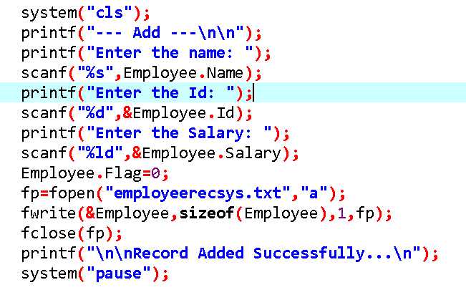
To add a record in file, we have used file handling.
We made a file pointer *fp,open the file and then stored the information using fwrite() function.

Slide 7
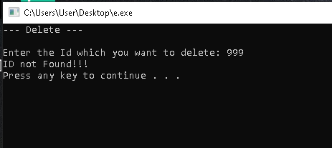
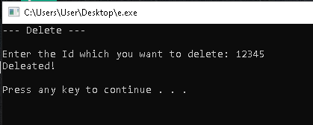
Delete A Record
If we type any random ID which does not exist in file then a message will be displayed say ID not found!!

Slide 8
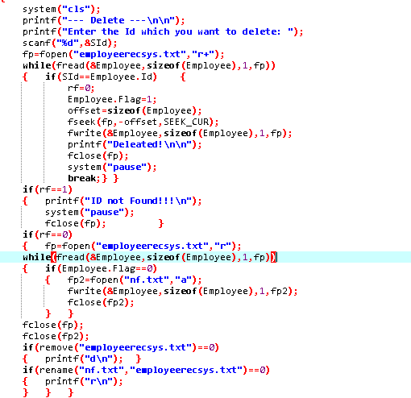
When we select the delete command, the program opens the file in which the records are saved and then searches if the record is present or not. If it is present then it deletes it otherwise it displays ID not found.

Slide 9
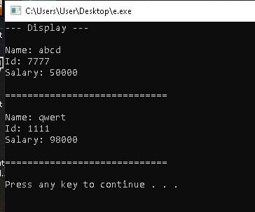
Display All Records

Slide 10
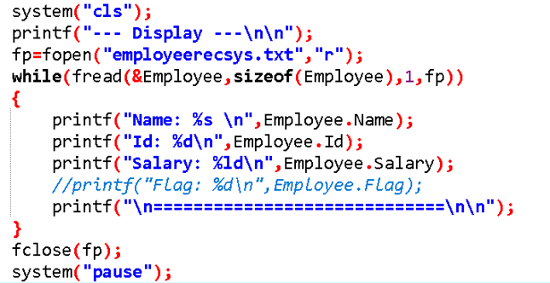
In order to display the records the program opens the data file and the reads and print the information on screen.

Slide 11
Thank You

